Slide 1

Objectives
Chapter 3
Create and initialize NumPy arrays using np.array(), np.arange(), np.linspace(), np.full(), np.zeros(), and np.ones().
Access and manipulate array elements using indexing, slicing, Boolean indexing, and reshaping techniques.
Perform mathematical and statistical operations using NumPy functions such as np.sum(), np.mean(), and np.log().
Explain and apply broadcasting to perform efficient operations on arrays of different shapes.
Understand NumPy array structure, memory storage, strides, and reshaping methods such as .reshape().ravel(), and .flatten().
Apply NumPy to calculate and interpret descriptive statistics, including mean, median, mode, range, variance, standard deviation, quartiles, IQR, and lower and upper outlier limits.
Numpy in python
Lecturer. Mohamed

Slide 2

Introduction to NumPy
NumPy stands for “Numerical Python.” It is a widely used Python library for working with numerical data, especially arrays, vectors, matrices, linear algebra, and other mathematical computations.
NumPy is mainly implemented in the C programming language, which allows it to process data much faster and use memory more efficiently than standard Python lists.
NumPy can be installed using conda (if not already):
conda install numpy

Slide 3
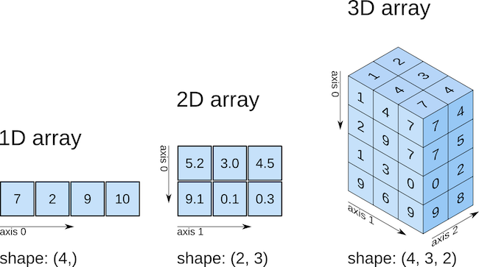
NumPy Arrays
What Are Arrays?
Arrays are n-dimensional data structures used to store multiple values in an organized form.
They can contain different kinds of data such as integers, floats, and strings, although NumPy arrays work best with numerical data.
NumPy arrays, also called ndarrays, are usually homogeneous, meaning that the elements in an array should have the same data type.
They are also designed to work efficiently with NumPy’s many built-in mathematical and statistical functions.

Slide 4
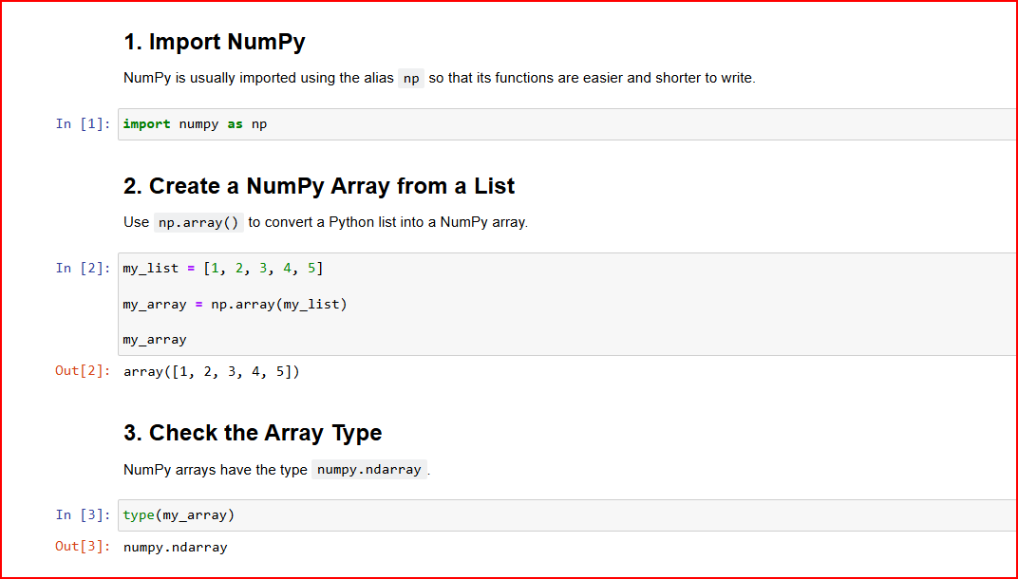
Creating Numpy

Slide 5
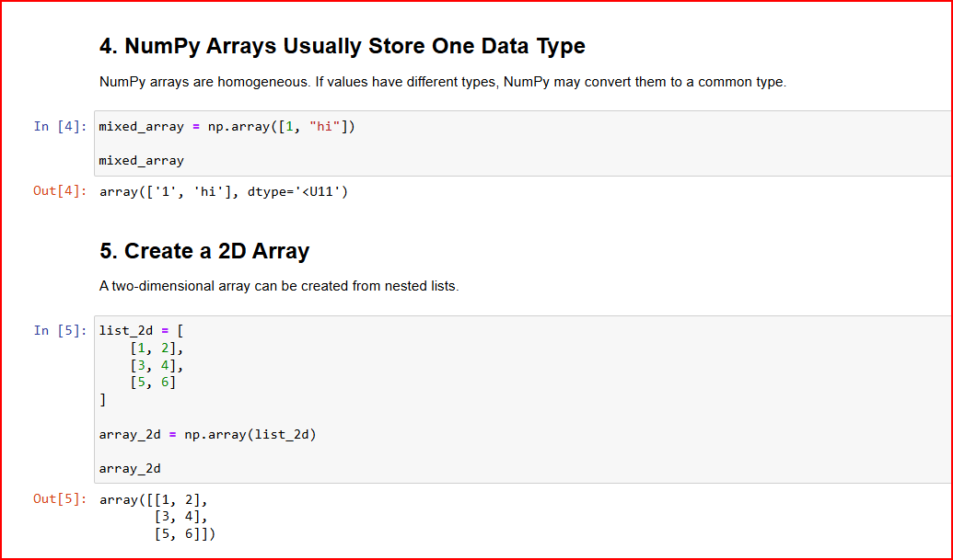
Continue…..

Slide 6
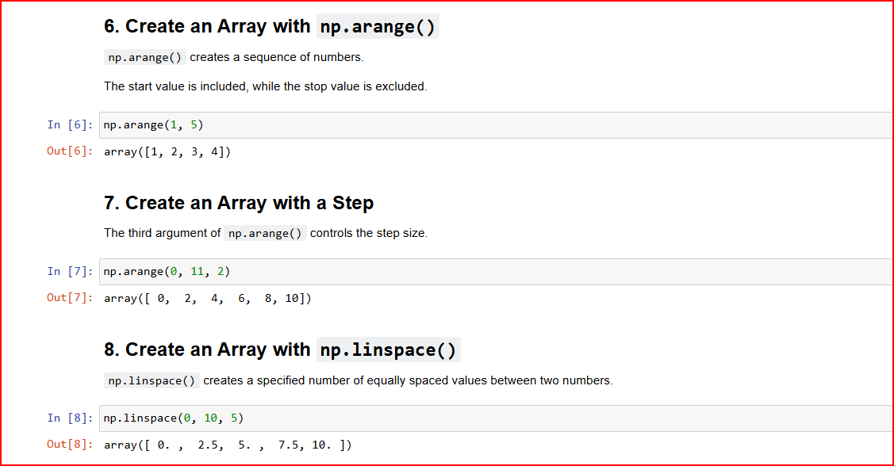
Continue…..

Slide 7
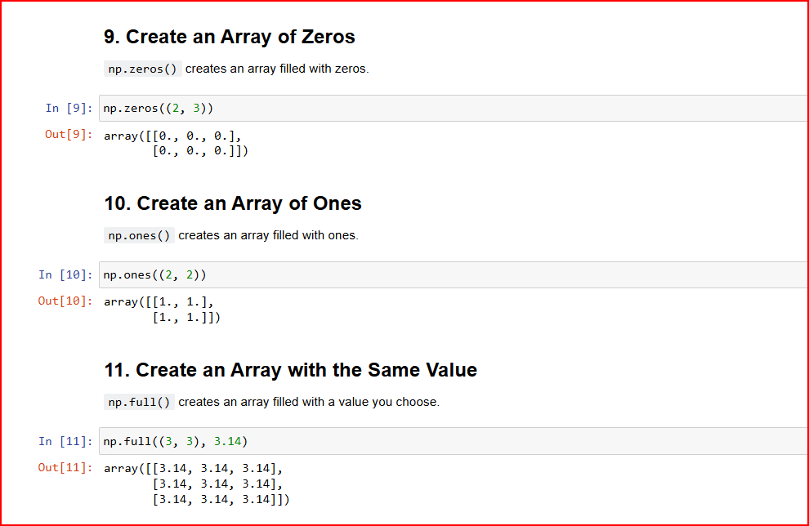
Continue…..

Slide 8
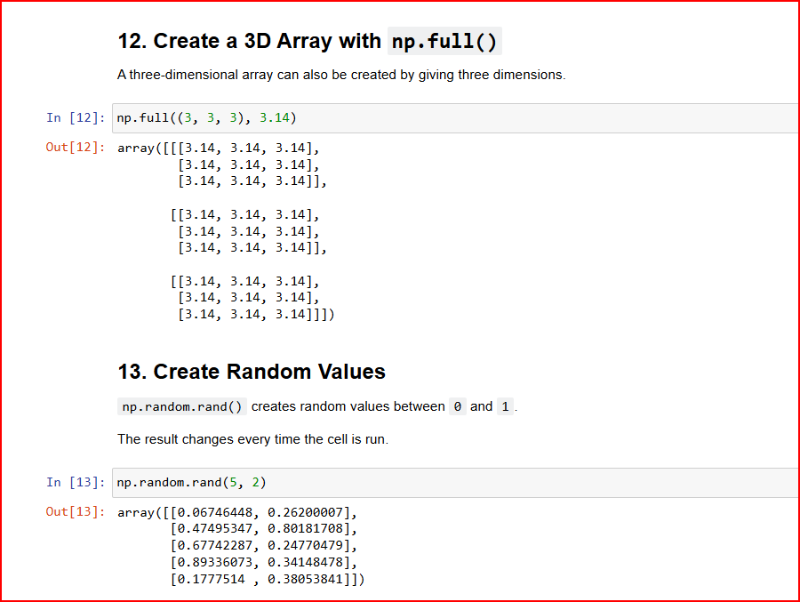
Continue…..

Slide 9
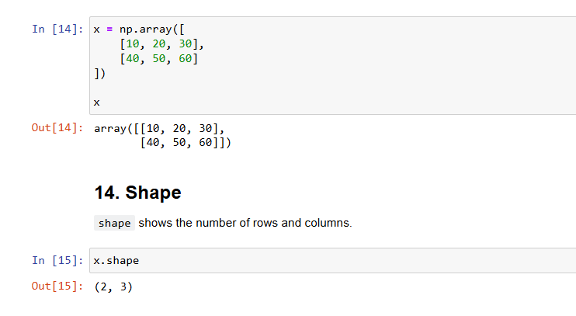
Useful NumPy Array Properties
The following properties help us understand the structure of an array.

Slide 10
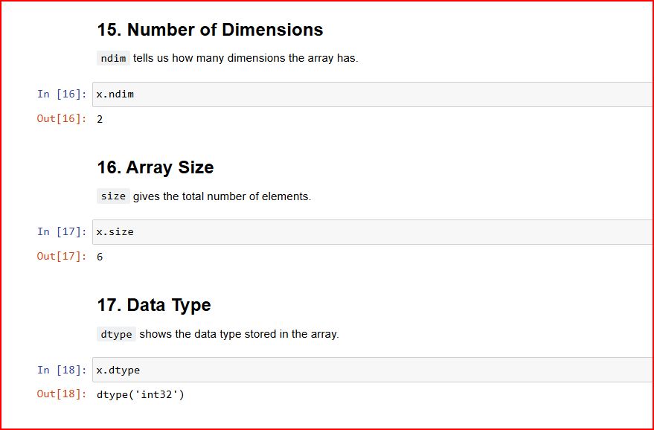
Continue…..

Slide 11
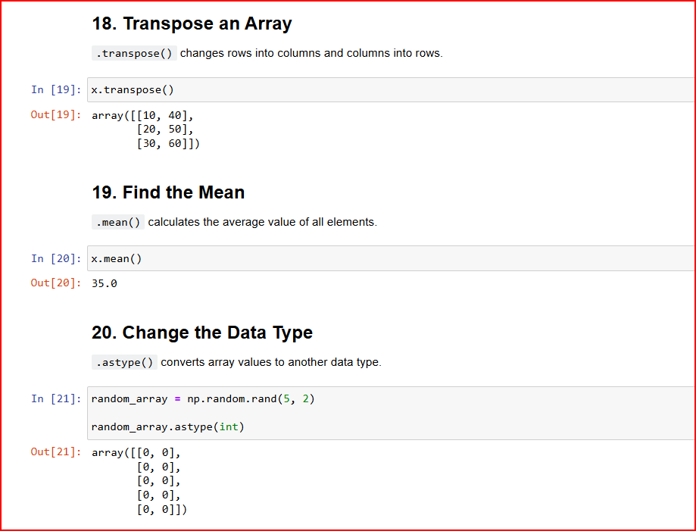
Continue…..

Slide 12
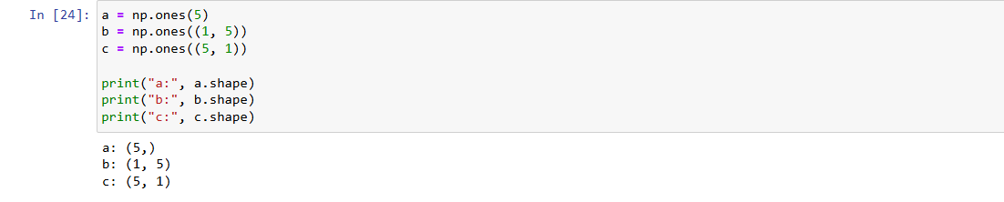
Continue…..
These arrays contain the same number of values but have different shapes.

Slide 13
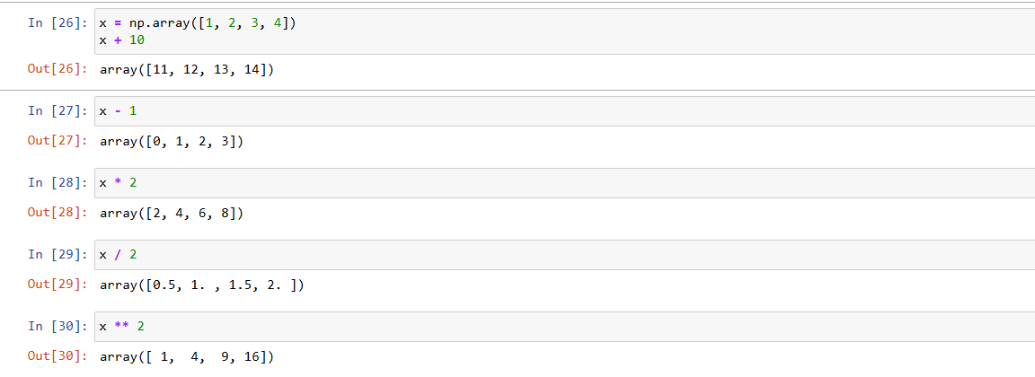
Mathematical Operations on Arrays
NumPy performs mathematical operations element by element.

Slide 14
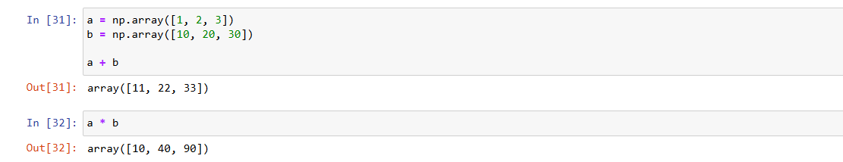
Operations Between Two Arrays
In NumPy, you can perform mathematical operations between two arrays element by element.
This means NumPy applies the operation to each pair of corresponding elements.

Slide 15
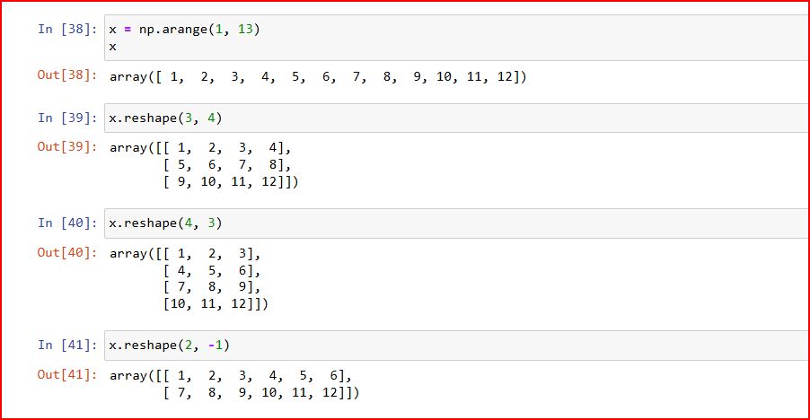
Reshaping Arrays
reshape() changes the arrangement of an array without changing its values.

Slide 16
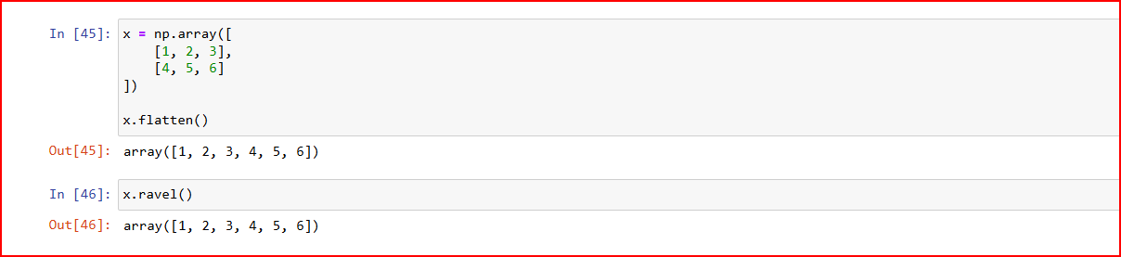
Flattening NumPy Arrays: .flatten() vs .ravel()
In NumPy, .flatten() and .ravel() convert a multidimensional array into a one-dimensional (1D) array.
The main difference is how they handle memory: .flatten() always returns a copy, while .ravel() returns a view when possible.

Slide 17
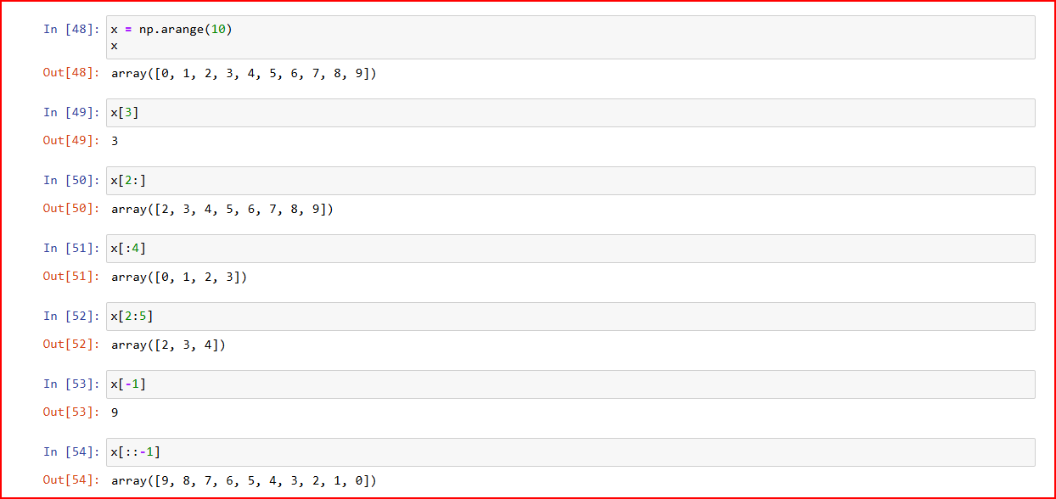
Numeric Indexing and Slicing
In NumPy, indexing and slicing help us access and select data from arrays.
Indexing: Selects a specific element.
Slicing: Selects a range of elements.

Slide 18
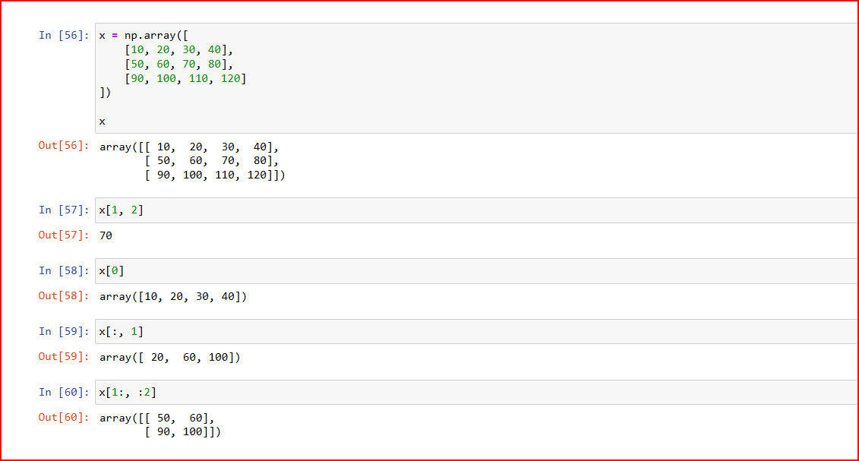
Two-Dimensional Indexing
array[row, column]

Slide 19
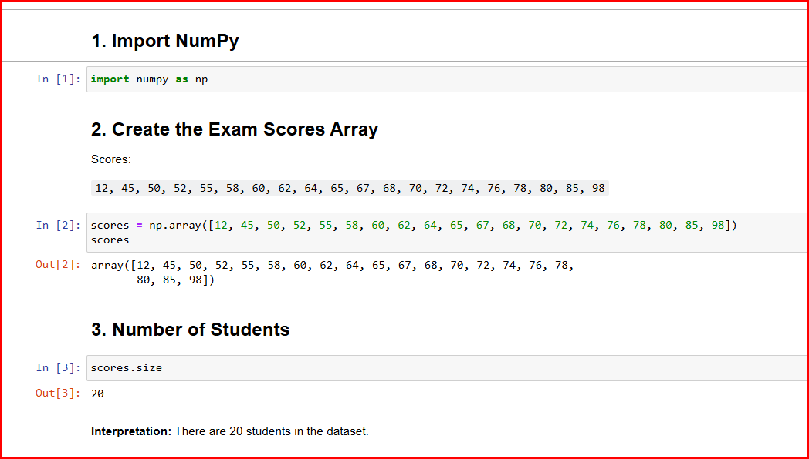
NumPy Descriptive Statistics
A teacher collected final exam scores for 20 students.
We will use NumPy to calculate descriptive statistics and detect outliers using the IQR method

Slide 20
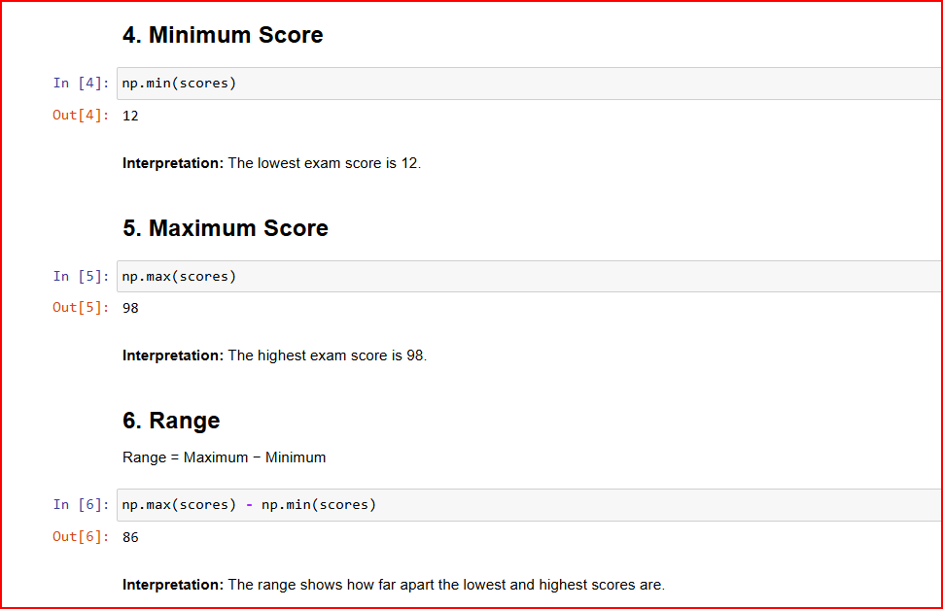
Continue…..

Slide 21
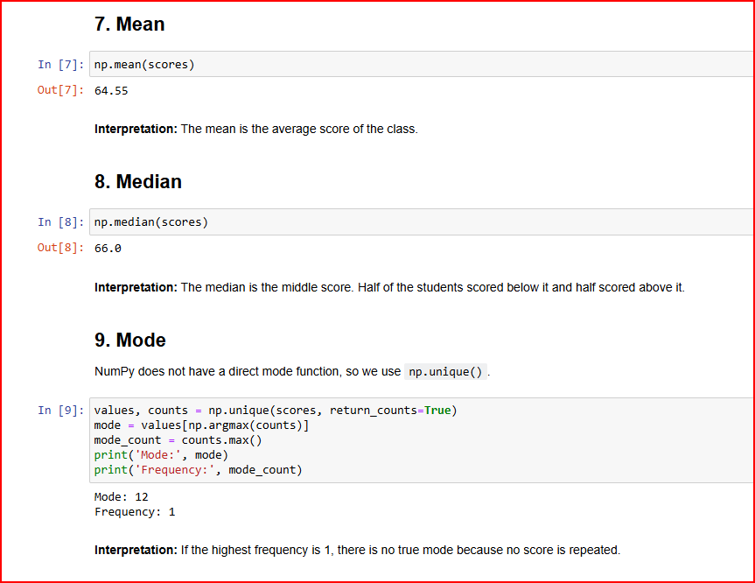
Continue…..

Slide 22
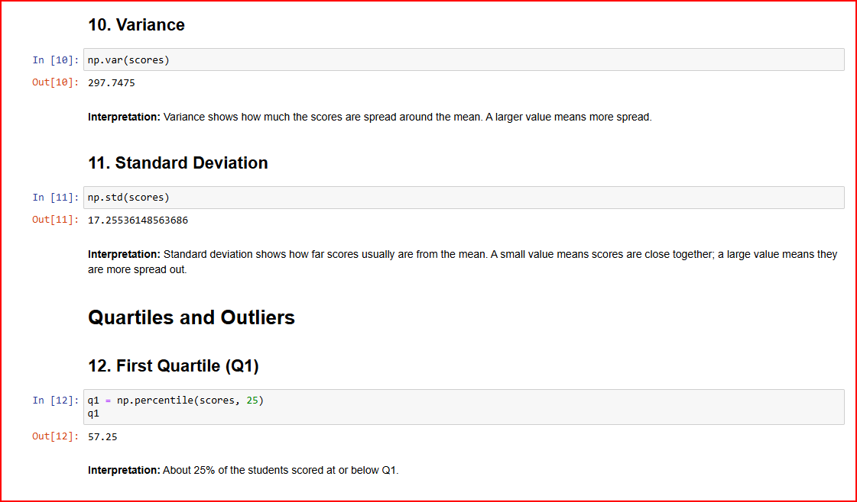
Continue…..

Slide 23
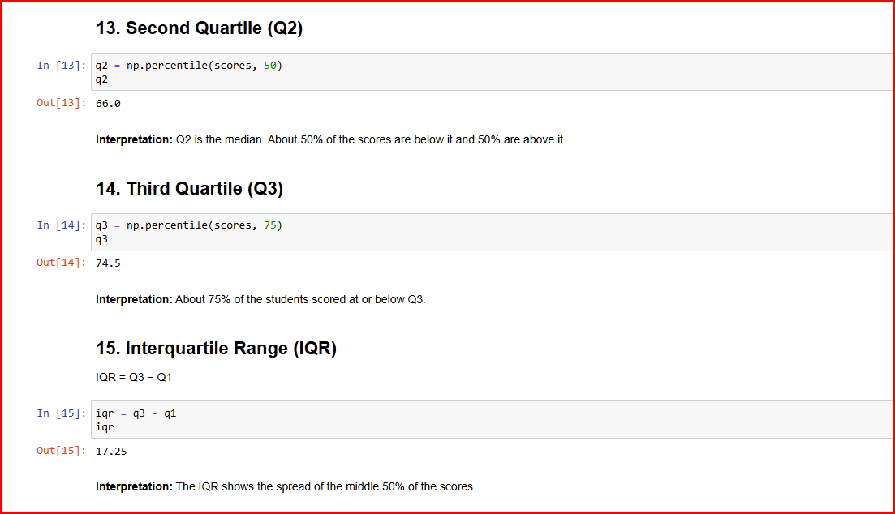
Continue…..

Slide 24
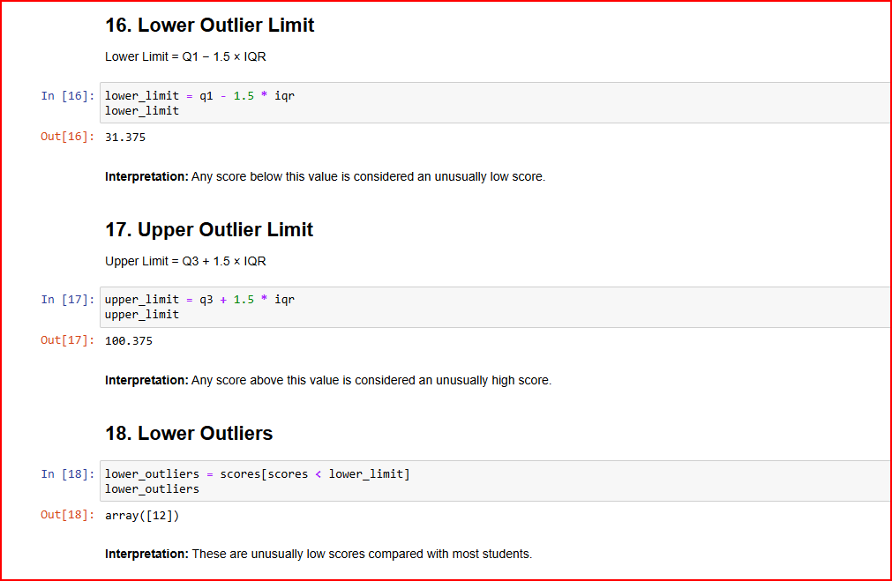
Continue…..

Slide 25
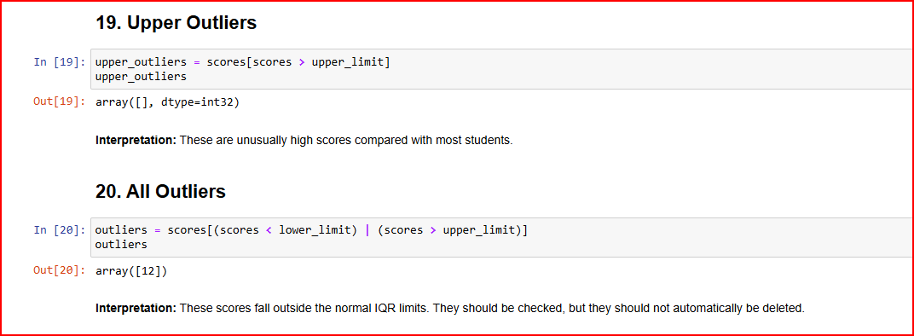
Continue…..

Slide 26



